Slide 1
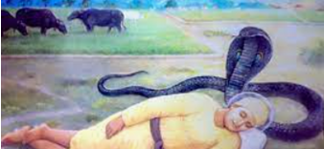
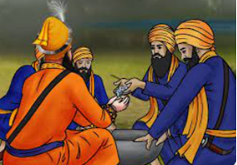
Key Content (New Learning)
know how some stories can teach people about what is important and how to behave. |  | know that stories can be an important way of expressing belief and meaning and can explain the relevance of a Sikh story. | know whether the Christmas story is true and what this might mean to Christians.
Unit Overview |  |  |  | Key Vocabulary
Lesson 1 Lesson 2 Lesson 3 Lesson 4 Lesson 5 End Point | To know that stories can teach us what is important and how to behave. To understand the importance of the Guru Granth Sahib. To understand how stories are important to sikhs and non-sikhs. To understand how stories are important to sikhs and non-sikhs. To write a persuasive piece to argue Sikh stories should be part of the curriculum. Complete a piece of writing using all learning to decide whether sikh stories should be part of the curriculum |  |  | Guru Granth Sahib: – The Sikh Holy book. Gurdwara – Sikh place of worship. Guru Nanak – The first of the ten Sikh Gurus. Vaisakhi: – A festival which celebrates the founding of the Sikh community, the Khalsa, in 1699. Khalsa – The Sikh community .
RE Knowledge Organiser
Term 3 – Sikhism

