Slide 1
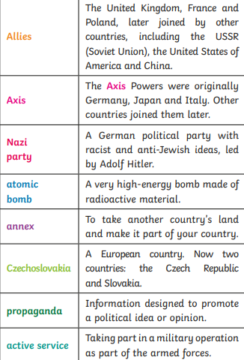
Key Content (New Learning)
Know that the second world war started September 1, 1939 |  | Families had to live off of rationed food- because there was not enough | Understand what the blitz was and its effect | Before the war most women had to stay home, in the war some helped to make weapons
Unit Overview |  |  |  | Key Vocabulary
Lesson 1 Lesson 2 Lesson 3 Lesson 4 End point | Know how and why the second world war started Blitz and evacuation Role of women Rationing Write a diary entry as a child after world war 2
History
Unit 3- world war 2

