Slide 1
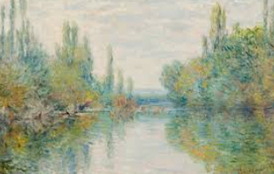
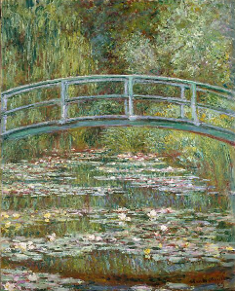
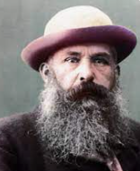
Key Content (New Learning)
To know about the work of Claude Monet |  | To explore pencil grades and pastels.
Unit Overview
Lesson 1 Lesson 2 Lesson 3 Lesson 4 Lesson 5 Lesson 6 End Point | Children will research Claude Monet and find out about his life and work. Children will be using different pencil grades and pastels to draw objects. Children will choose which landscape they want to use and complete their first draft. Children will draw their final sketch, using a range of pencil grades – on paper Children will complete their final piece by adding pastels. Children will evaluate their work. Final Piece |  |  | Key Vocabulary Claude Monet - he was a famous painter. Pencil Grades - The "grade" or "hardness" of the pencil. This means that it's darker, smoother, smudgier and doesn't hold as sharp of a point. Landscape - A landscape is the visible features of an area of land. Sketch - a rough drawing representing the of an object or scene. Evaluating - To assess how something went and say what went well and what could be improved.
Year 4 (Term 5) Claude Monet- Art Unit Overview
To draft chosen sketch.
To complete final piece.

