Slide 1
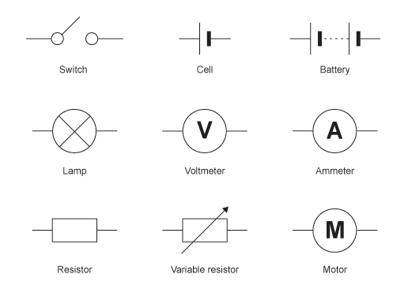
Key Content (New Learning)
Use recognised symbols when representing a simple circuit in a diagram. |  | Associate the brightness of a lamp or the volume of a buzzer with the number and voltage of cells used in the circuit. | Compare and give reasons for variations in how components function, including the brightness of bulbs, the loudness of buzzers and the on/off position of switches.
Unit Overview |  |  |  | Key Vocabulary
Lesson 1 Lesson 2 Lesson 3 Lesson 4 End Point | To know the history of electricity. To recognise symbols when representing a simple circuit in a diagram To know that the number and voltage of cells used will impact the buzzer/bulb. To make my own game which involves a circuit. Assessment test. |  |  | Current- a flow of electrons in a circuit Electrons- small particles that travel around an electric circuit Voltage- the force of an electrical current that makes electricity move through the wire Filament- a conducting wire or thread with a high melting point which forms part of an electrical bulb Resistance- A measure of the difficulty of passing an electric current through a conductor. The more resistance in a circuit, the less electricity will flow through.
Science Unit Overview
Unit 2 - Electricity

