Slide 1
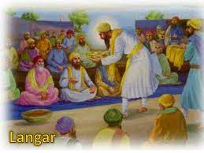
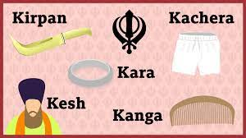
Key Content (New Learning)
know the different levels of commitment I show to different things and explain these priorities. |  | know links between how Sikhs practise their religion and the beliefs that underpin this. | know how to ask questions about some of the ways Sikhs choose to behave and the levels of commitment they show.
Unit Overview |  |  |  | Key Vocabulary
Lesson 1 Lesson 2 Lesson 3 Lesson 4 Lesson 5 End Point | Personal commitments - commitment tree To understand key sikh beliefs - video and note taking To understand sikh beliefs - create a poster To understand what is important to sikhs - Venn diagram To be able to think about what is important to us Ranking the importance of different aspects of the Sikh religion. |  |  | Langar- where anyone can eat; so long as they are willing to eat with everyone else. The 5 Ks - 5 physical symbols worn by Sikhs who have been initiated into the Khalsa. Gurdwara - the place where Sikhs go for worship together. golden temple - regarded as the most sacred place of worship for the Sikhs.
RE Knowledge Organiser
Sikhism

