Slide 1
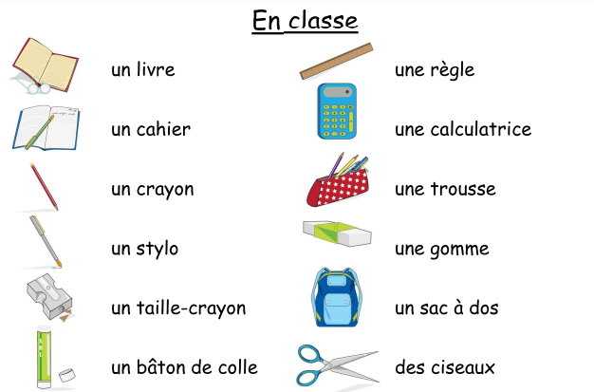
Key Content (New Learning)
Name in French, the nouns and determiners for 12 common classroom objects. |  | To fully understand the role of gender and plurality in the choice of possessive adjectives in French.
Unit Overview
Lesson 1 Lesson 2 Lesson 3 Lesson 4 Lesson 5 End Point | To know how to recognise, recall and spell seven different classroom items. To learn a further five classroom object nouns with their indefinite articles/determiners To know how to answer the question ‘Qu’est-ce qu’il y a dans ta trousse ?’. To consolidate the previously learnt language and introduce the possessive adjectives ‘mon’, ‘ma’ and ‘mes’ in French To learn how to use the negative structure ‘Je n’ai pas de…’ (I do not have) in French EOU Quiz |  |  | Key Vocabulary
Year 4 Term 5 French Unit Overview
In the classroom
To also improve spellings in French by completing a variety
of written based activities.

