Slide 1
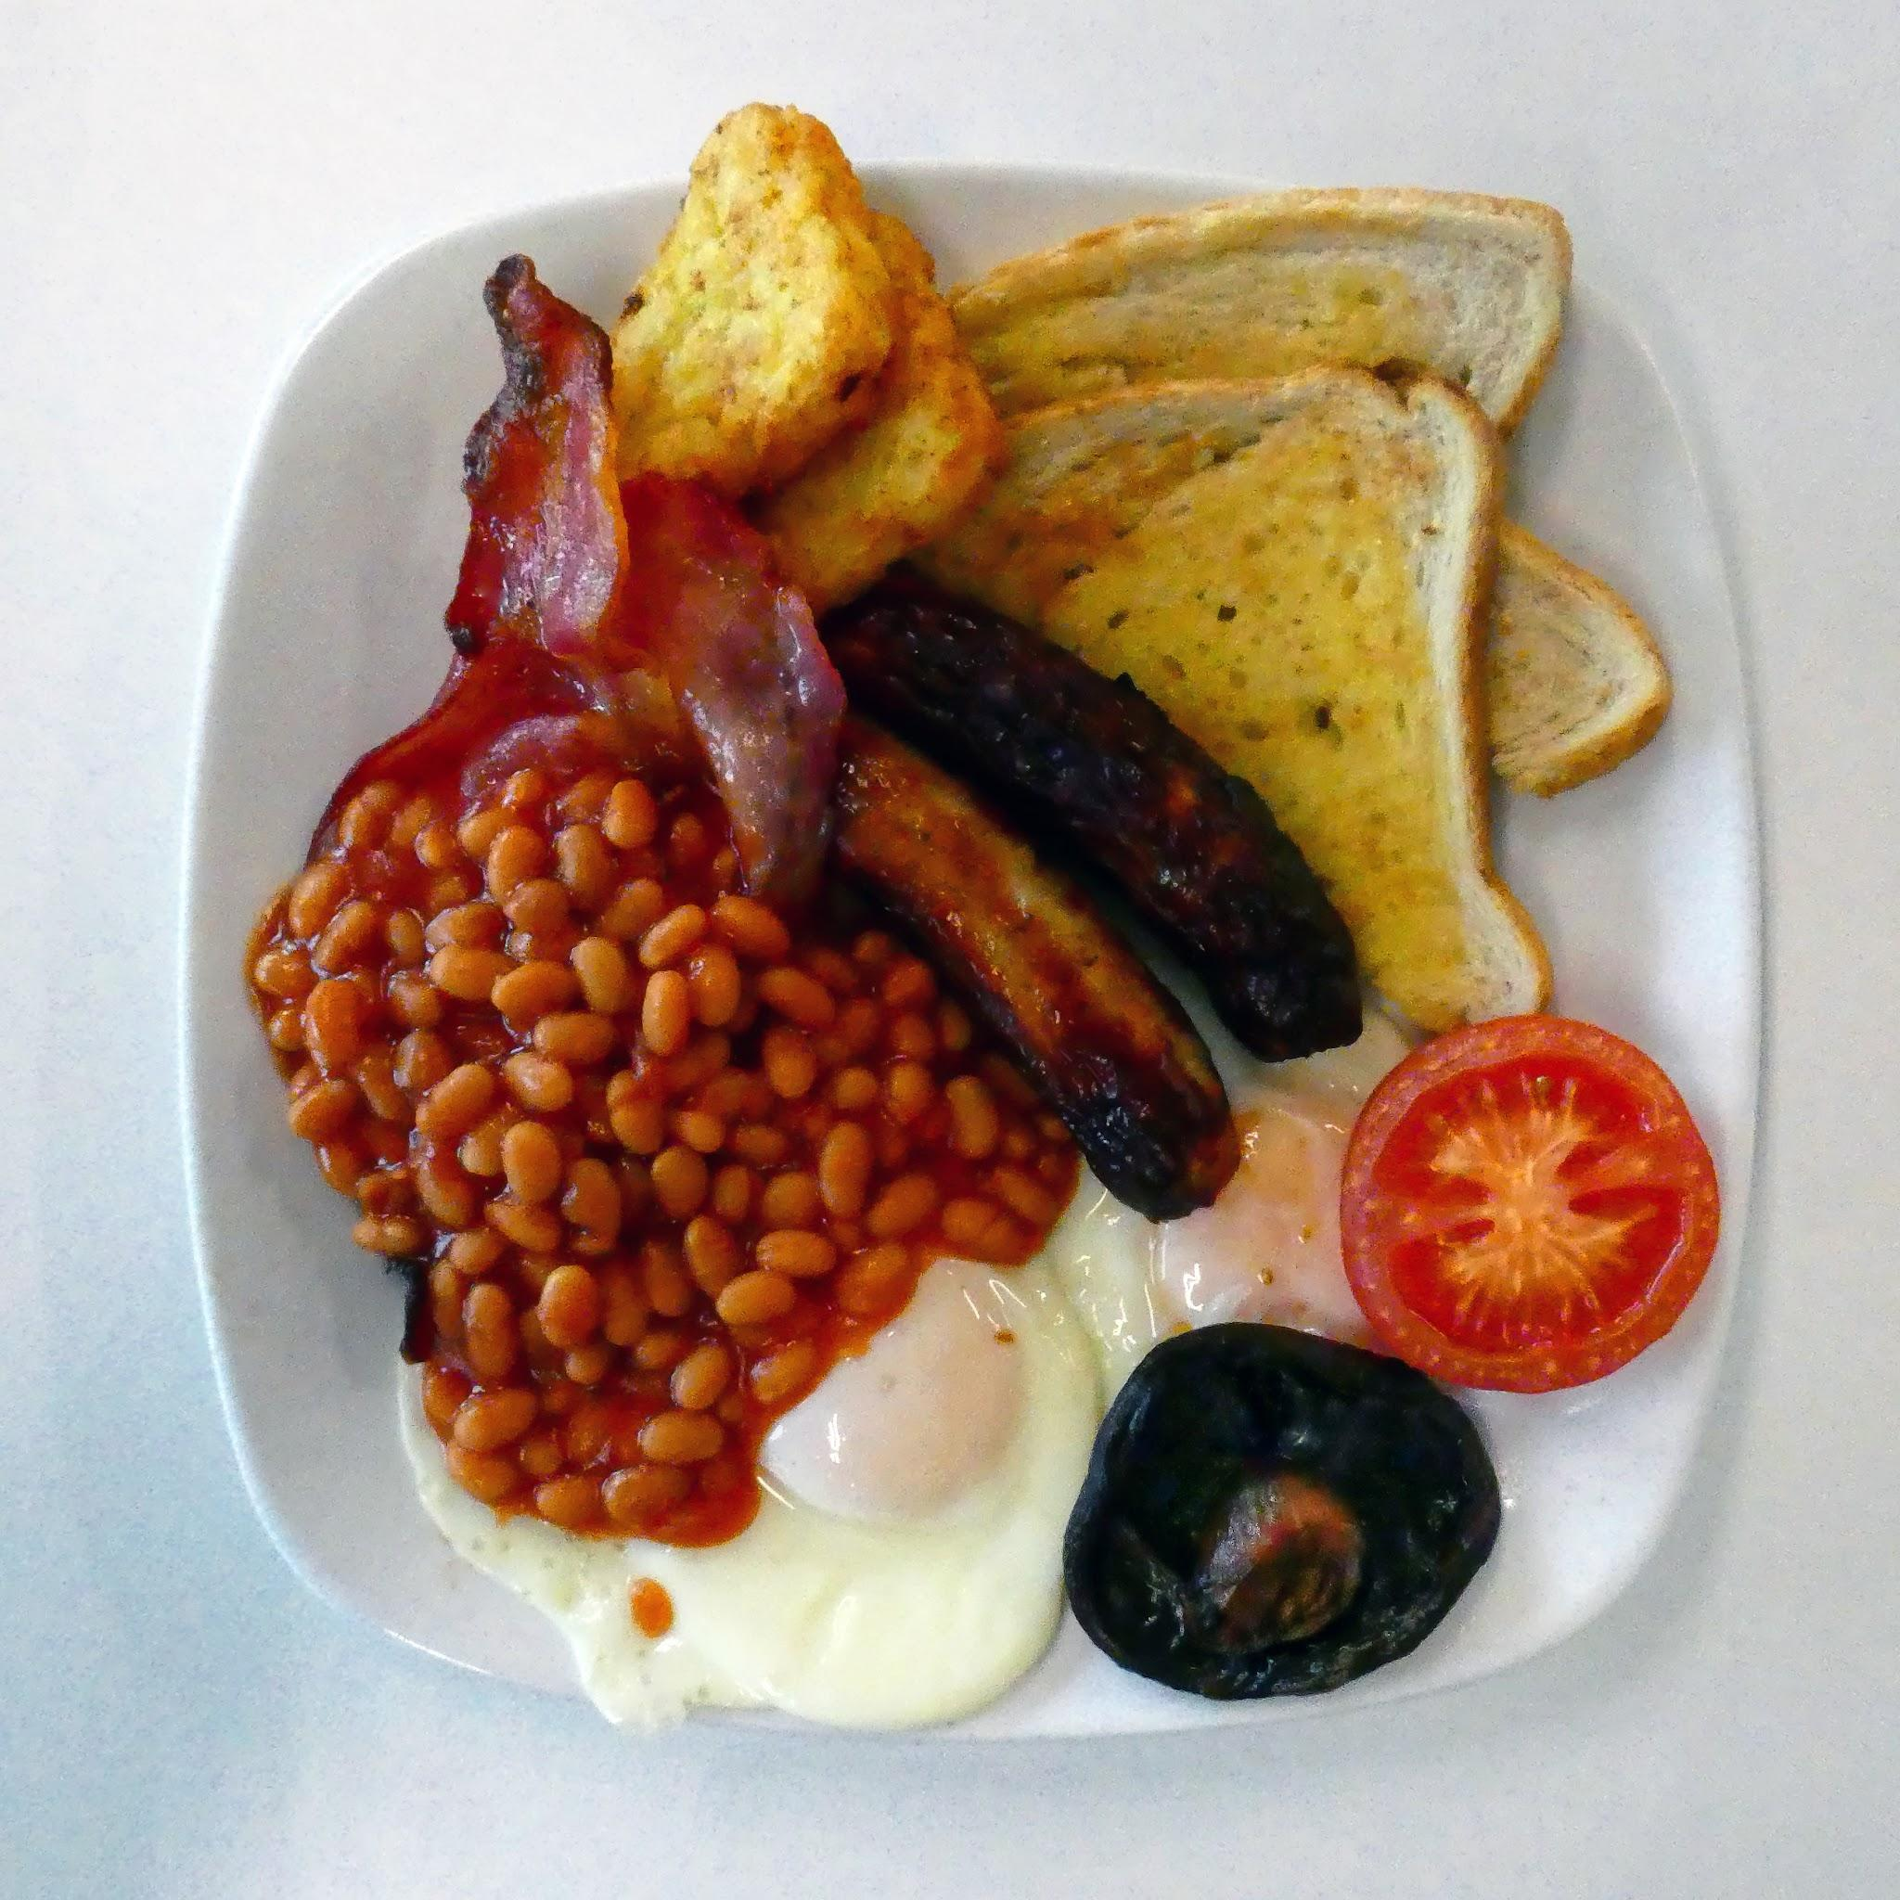
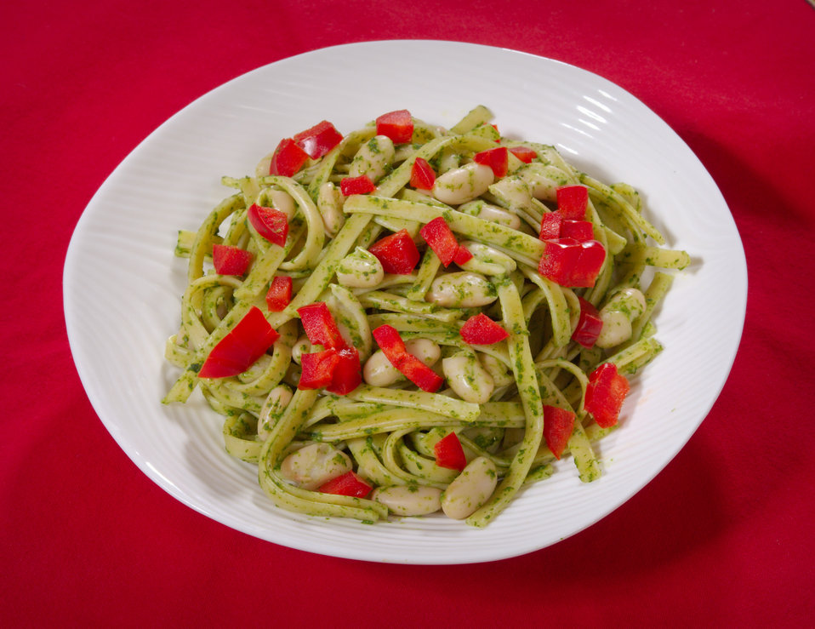
Key Content (New Learning)
Demonstrate good hygiene. |  | Knows how to peel, grate, cut, mix, mould. Knows how to use a range of tools safely when cooking. | Knows how to turn on, set temperature and heat food safely using hobs and ovens (with supervision) To set a timer and observe food cooking. | Knows how to make a cooked breakfast. Knows how to cook a pasta dish.
Unit Overview |  |  |  | Key Vocabulary
Lesson 1 Lesson 2 Lesson 3 Lesson 4 End Point | To taste products and plan my own pasta dish. To make, eat and evaluate my pasta dish. To taste products and plan my own breakfast. To make, eat and evaluate my breakfast. By the end of this unit you will have made 2 dishes, a pasta dish and a breakfast. |  |  | Allergy- a condition in which a person's body has an unusual reaction to certain things. Gluten- a protein found in certain cereal grains, esp. wheat, that gives dough an elastic texture. Intolerance- inability or unwillingness to accept Nutrients- something in food that helps people, animals, and plants live and grow. Processed- having been handled or changed according to a process. Boil- of a liquid, to produce bubbles of water vapor when heated to a high enough temperature Fry- to cook in hot butter, oil, or other fat. Utensils- a device, instrument, or container used in a kitchen. Carbohydrate- a compound made of carbon, hydrogen, and oxygen. It is formed mainly by plants, and it is used in the body to easily produce and store energy.
DT Knowledge Organiser
Unit 2 - Food and nutrition

